Slide 1
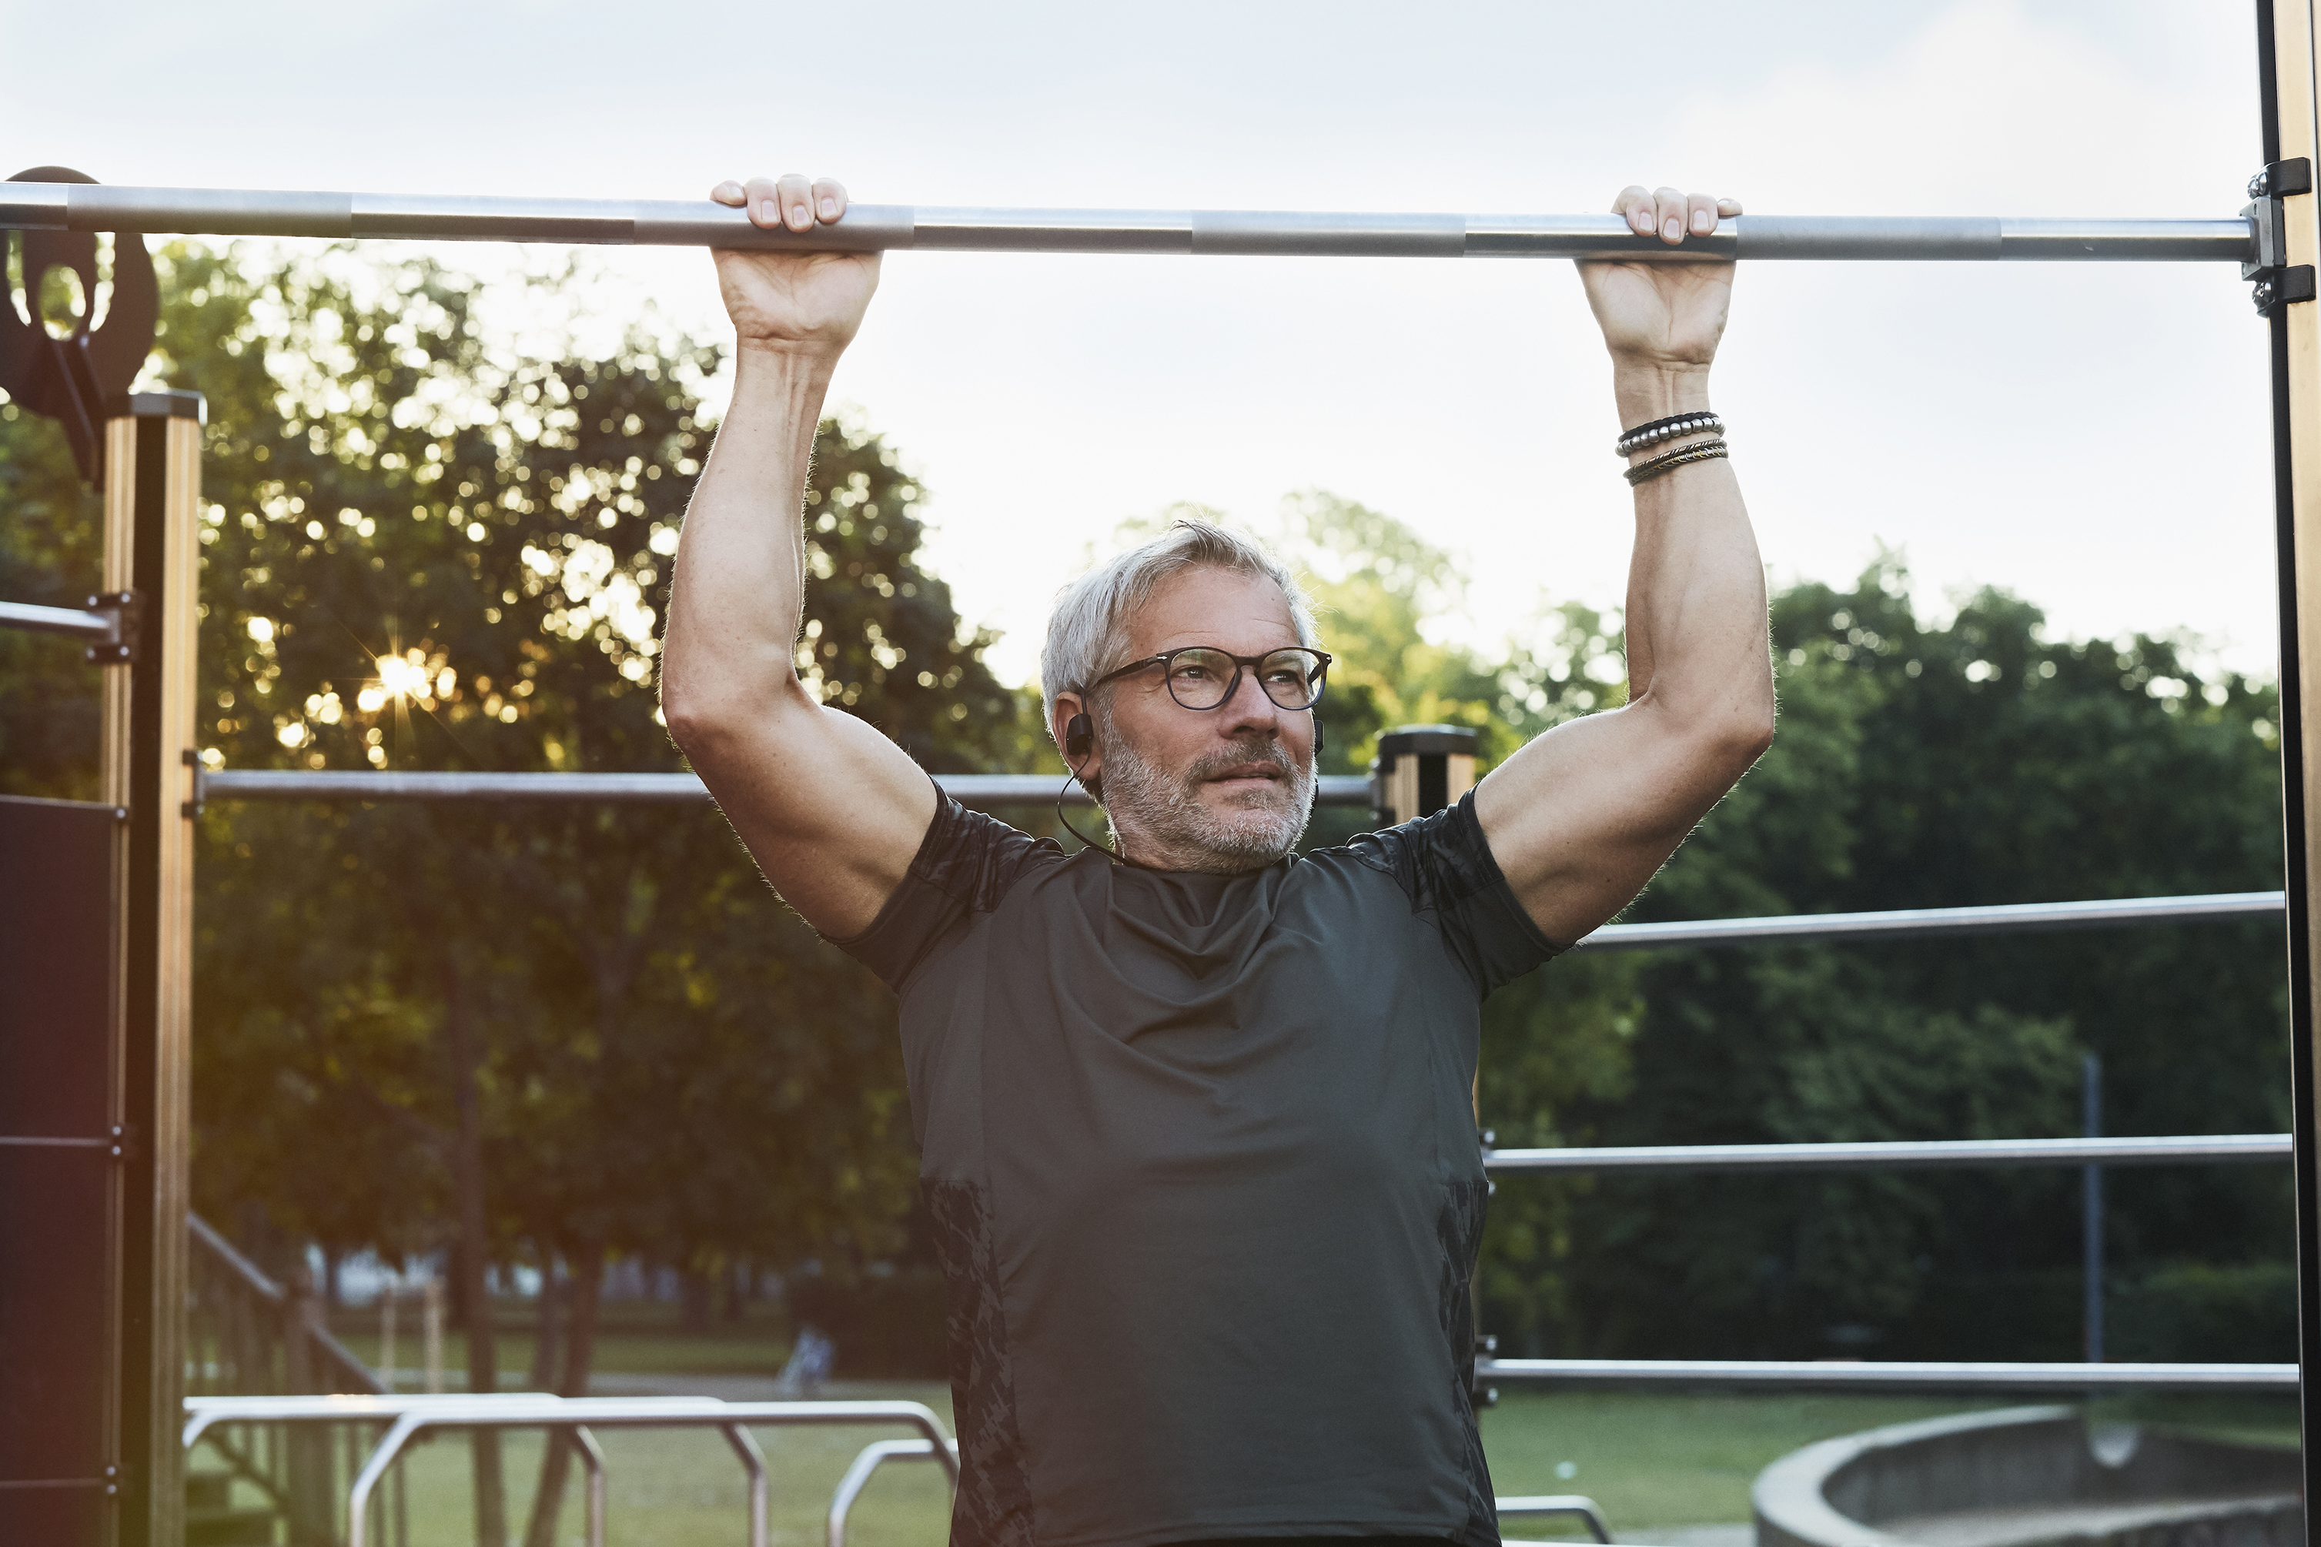
Gym Weekender
Devansh Verma (ID 220560366)

Slide 2


Our Mission
Partner with Pure Gym and Age UK to promote mental and physical wellbeing of seniors over 60.
8 lessons available, including Zumba, Yoga, and HIT classes led by experienced instructors.
Accessible through Age UK's website page or by phone registration
Cost of £3 per person, subsidised by Pure Gym

Slide 3
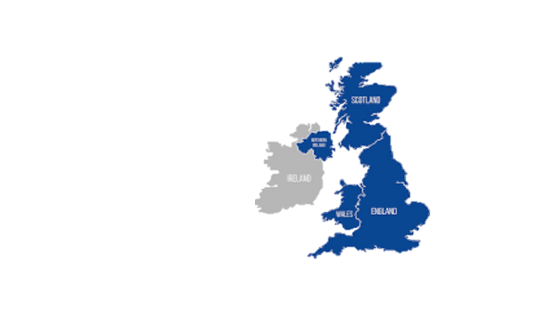

Target Market
To respond to Age UKs report – in terms of COVID19 problems.
Community focused by providing a safe and positive space for the elder community.
Provide a community space for elderly people.
Affordable opportunity for elderly people.
Connecting younger population to older.
UK is an ageing population – 11 million people (18.6% of out population)

Slide 4
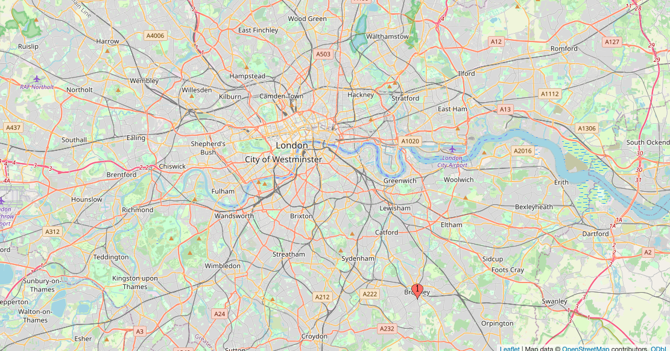
Location
Centered in Bromley
Research based on…
Office for National Statistics (ONS) - Bromley (18.4%) of elderly
Bromley 17 care homes
Cost of Living considered according to IMD, Bromley is 56th out of 317 English local authorities - measure of relative deprivation

Slide 5
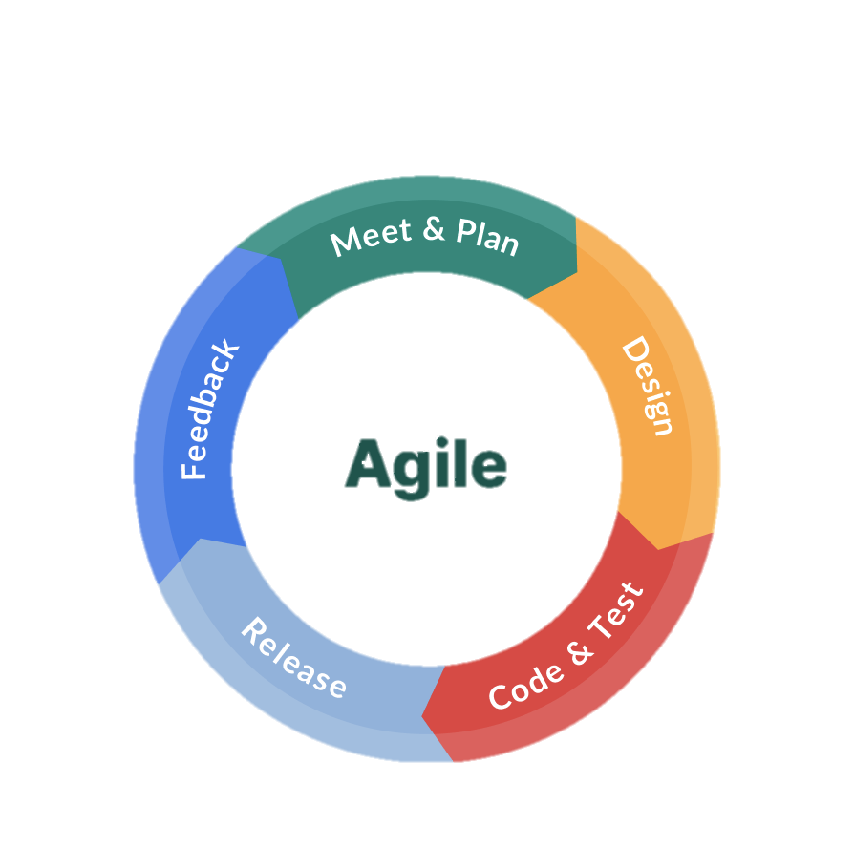
Agile Scrum Framework
Agile Justification
Contemporary framework that emphasises the importance of collaboration, flexibility and client/ customer collaboration.
At the heart of it - it values individuals and interactions over processes and systems.
Responds to feedback, testing and implementation
Scrum Implementation:
Breaking down work into small, manageable chunks - between different teams.
Client focused - looking to run focus groups among the elderly
Flexible - responding to the needs of the elderly
Collaborative - working with different organisations

Slide 6
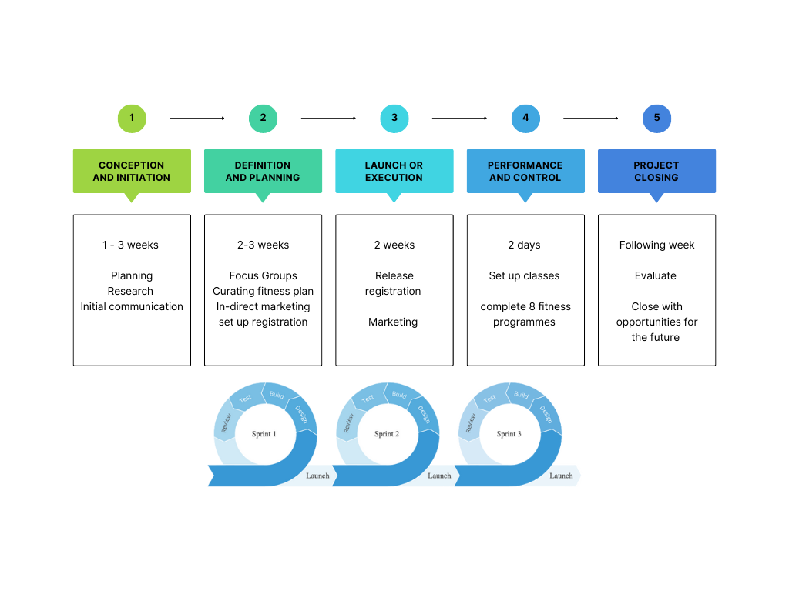

Slide 7
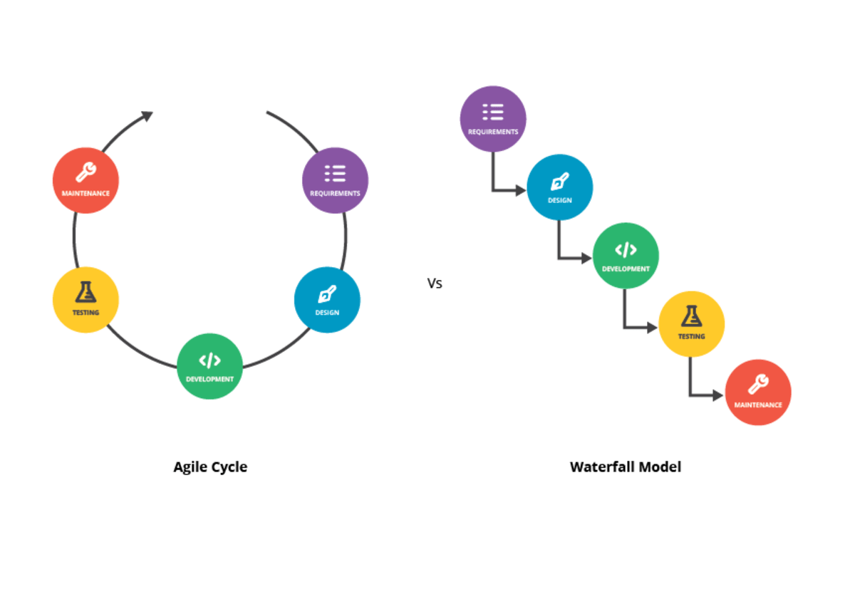
Framework Analysis
Agile Limitations:
The assumption that teams will cooperate, work together effectively and consistently.
The dependence of customer collaboration.
Our Response to this……
New partnerships can be exciting - diversity offers new ideas and thought. A strong PM team/ coordinators are in place to initiate communication and prompt closure of tasks.
We are working with experts and people who have years of research with elderly people (thus sensitive to social circumstances and mental health)

Slide 8

Comparing Frameworks
Agile instead of waterfall
Agile aligning with values and mission (hierarchies)
Agile is contemporary + well known.
Waterfall process is more rigid.
Waterfall can be timely due to documentation.
Lean conscious
(save material + promote efficiency)
Charity based - looking to save on resources where we can
Responding to ‘Muri’ (an overburden) - for our team, thus evenly divide roles

Slide 9
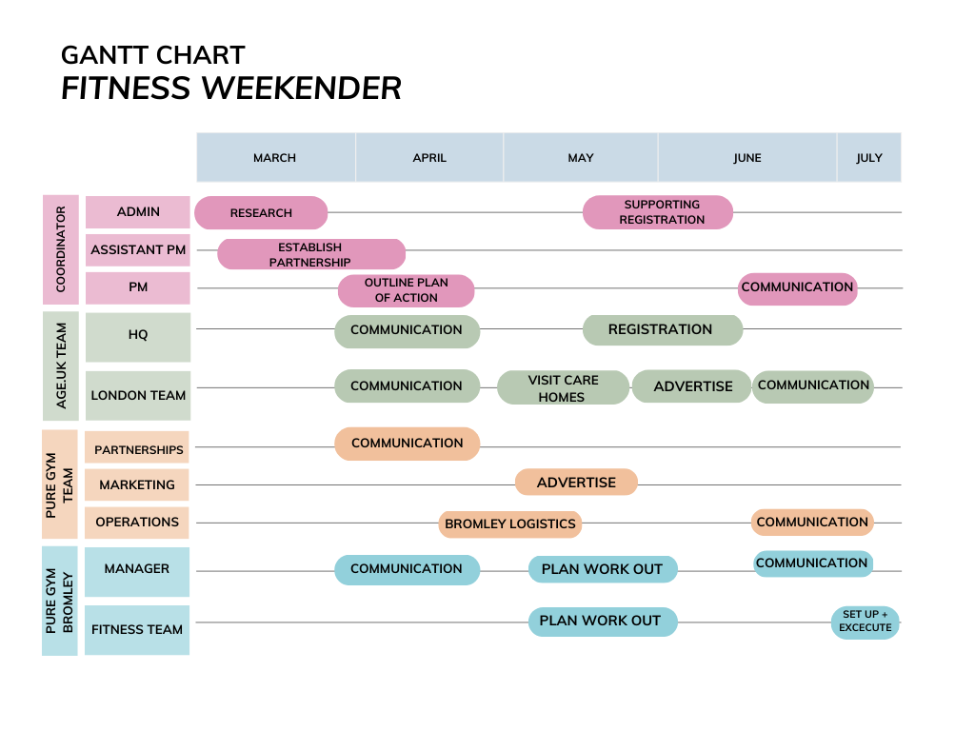
Why have we opted to use a Gantt Chart?
Easy to follow
Provides a clear overview
Includes every role and activity
Clear expectations
Prompts communication
Everyone remains on the same page

Slide 10






Resource management
Age.UK Manager
Gym Manager
Gym Staff (Trainers)
Gym Doctor
Age.UK Registration Process Team
Age.UK Volunteers

Slide 11
Roles BreakDown For the Teams:
Age.Uk is mainly responsible for the marketing and registration purposes.
Responsibilities of the team
Manager
Registration team
Volunteers
Marketing
Coordinating with the Process Team
Handling the Operations
Visiting the Old age Homes
Helping with marketing
Handling registration for the events
Updating participants with any changes

Slide 12
Roles BreakDown For the Teams:
Pure Gym is responsible for organizing the event and managing the classes and the event.
Responsibilities of the team:
Trainers
Manager
Doctor
Responsible for smooth running of the event
Planning the best kind of session for the elderly
Making arrangement for the event.
Managing the goodies pack for the enrolled people and the refreshments
Making sure everything runs smoothly
Looking after the participants Health
Making sure everyone is alright during or after the session

Slide 13

Who are the Stakeholders?
Clients ( Old Age People )
They are the primary stakeholders. The service is being provided to them.
Service/Health Care Providers ( Pure Gym )
They are responsible for the delivering the care to the primary stakeholders.
Government Agencies ( Age.UK )
They are responsible for the partnership, awareness and successful execution of the service

Slide 14





How the Stakeholders will be connected?
Meetings
Phone Calls
Update the plan
Feedback
Regular Updates

Slide 15

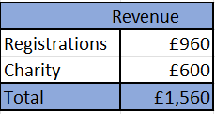
Sourcing Money:
Registration fees, which will be £3 per person.
Charity from age.uk

Slide 16
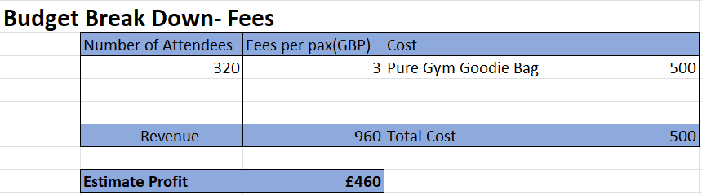
DETAILED BUDGET BREAKDOWN
Participants will get Gym bag containing a “Pure Gym” zipper and a T-shirt. The budget is around £500.

Slide 17
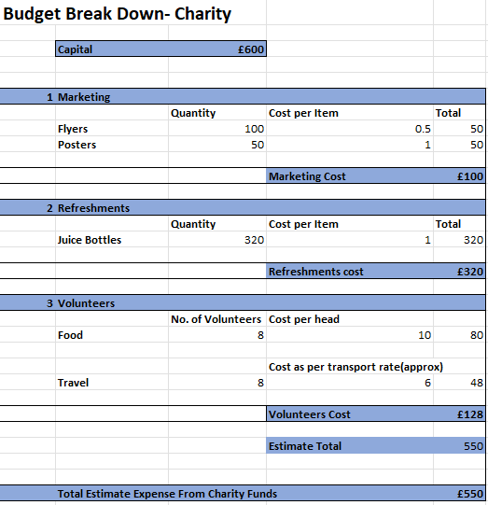
DETAILED BUDGET BREAKDOWN
Provide Healthy refreshments including Fruit Juices for the participants - Setting aside £320 budget for the refreshments
Provide travel and food costs for volunteers who will visit the sites to interact with potential participants and familiarise them with what exactly the event is about – Setting £128 within the budget.
We will be advertising the event through flyers, posters, or other means. Our budget for marketing is around £100.

Slide 18

Contingency Plan
In case of low turnout or if the participants are unable to attend due to unforeseen circumstances, you may need to reschedule the event or offer refunds. Be sure to have a clear refund policy in place and communicate it to participants ahead of time.
If unforeseen expenses arise during the event that exceed the budget, you should have a plan in place to address them. This could include cutting back on some expenses or finding additional funding if necessary.

Slide 19
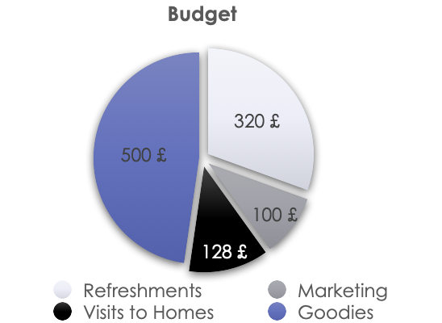
Overall Spending:
This budget covers the main expenses associated with the event, refreshments, and marketing.

Slide 20
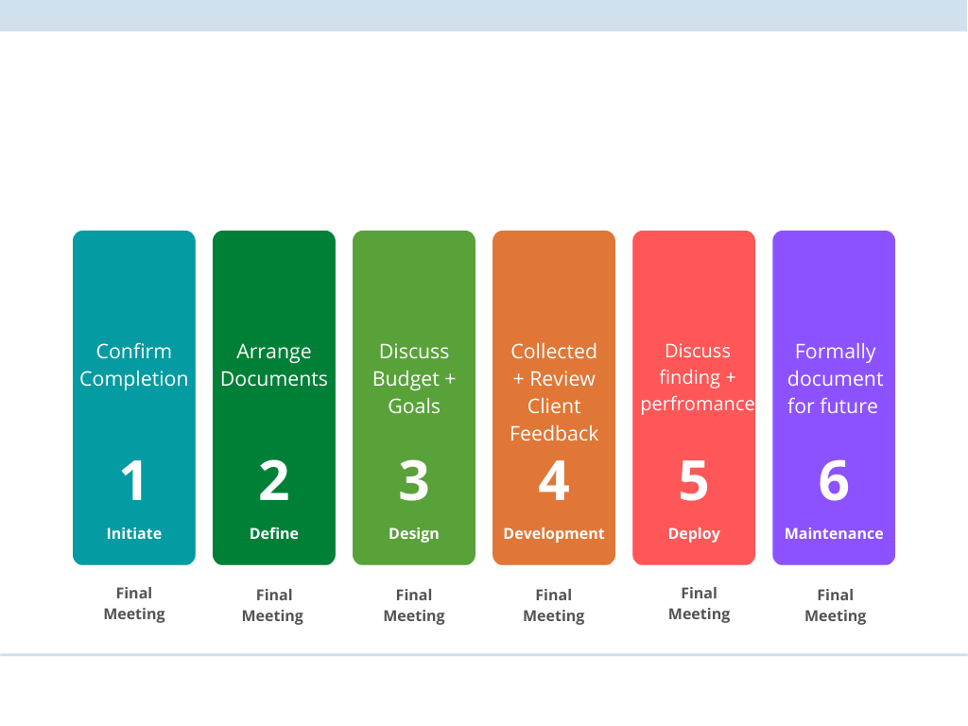
Project Closure
This process is essential for this project as it...
Helps to maintain stakeholder relationships for future ventures
Provides an opportunity to document the success of the event - both formally and for marketing purposes
Reflects on the reviews made by clients - how this supported them

